Slide 1
Line Following with TurboPi

Slide 2
Road Map
Define Control Scheme
Process Data
Create, Train, and Test ML Model
Experiment with TurboPi

Slide 3





The Control Scheme

Slide 4
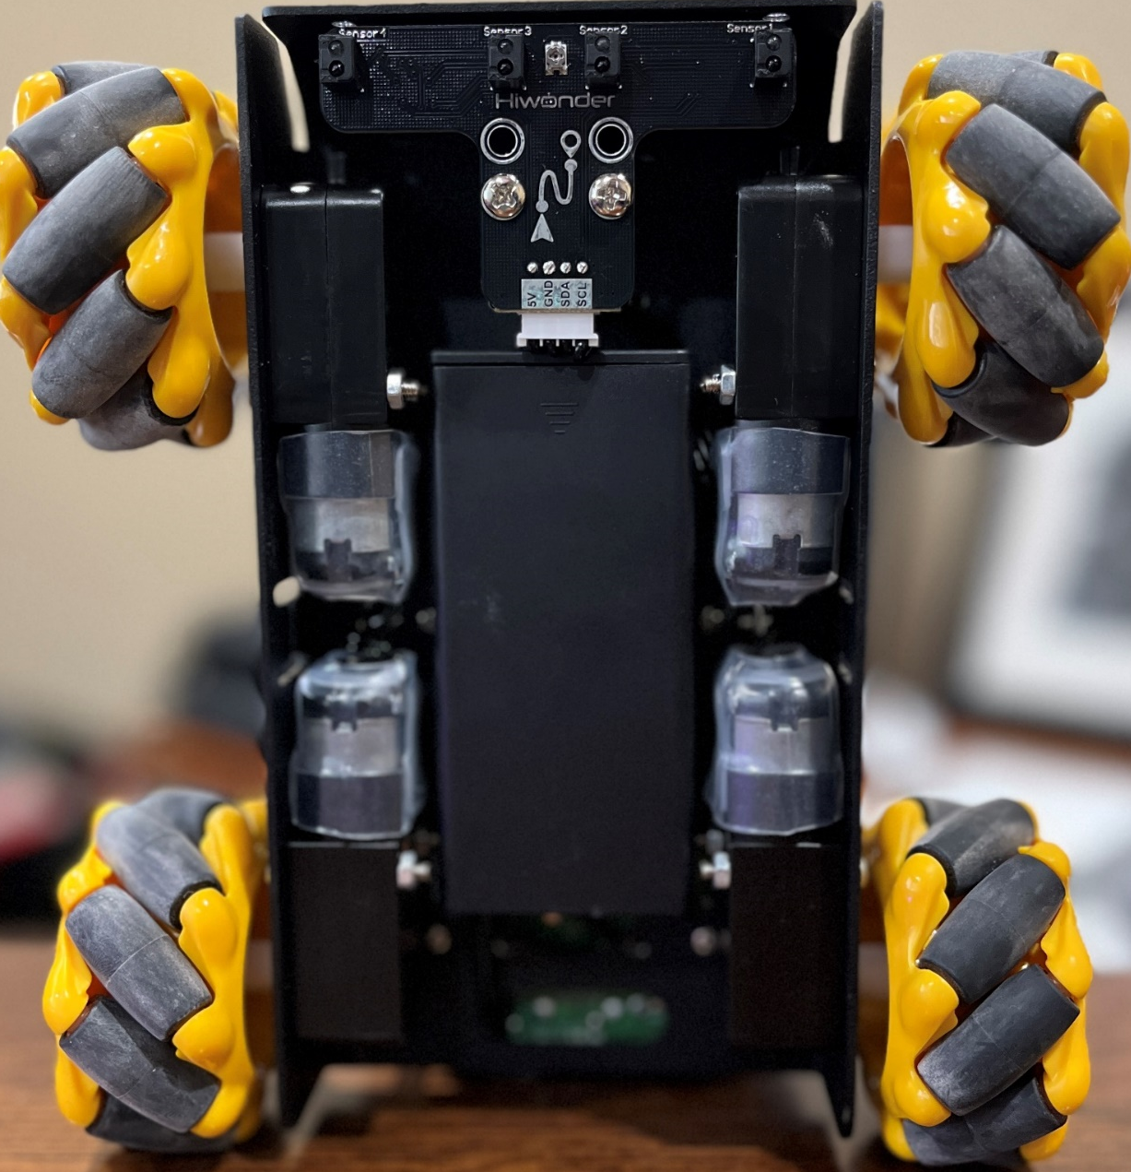
Line Following with IR Sensors
Use an array of IR sensors positioned at the front of the vehicle
Keep the line between the sensors to make the vehicle follow the line
Turn Left
Go straight
Sensor Triggered
Left Triggered
Right Triggered
Turn Right
No Trigger

Slide 5
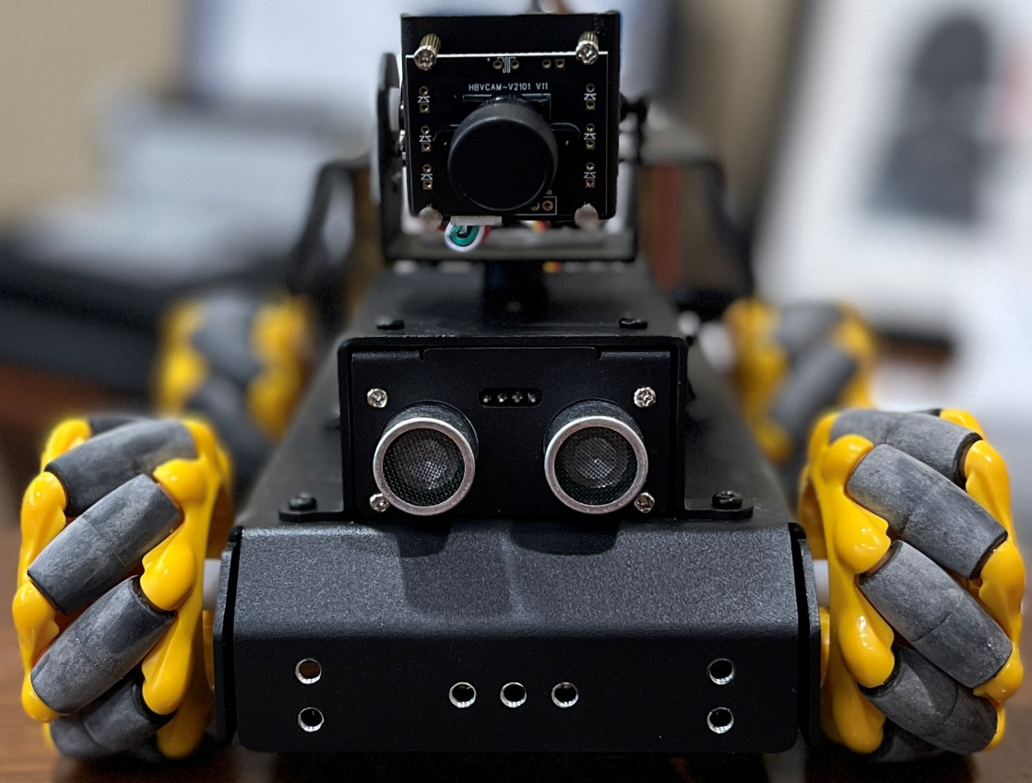
Line Following with Camera and ML
Use a camera mounted at the front of the vehicle to observe the road
Crop two sub-images from useful locations in the original image
Use classification on the sub-images to identify if the line has crossed into either image
Turn Left
Go straight
Sensor Triggered
Left Triggered
Right Triggered
Turn Right
No Trigger

Slide 6
Data Processing

Slide 7
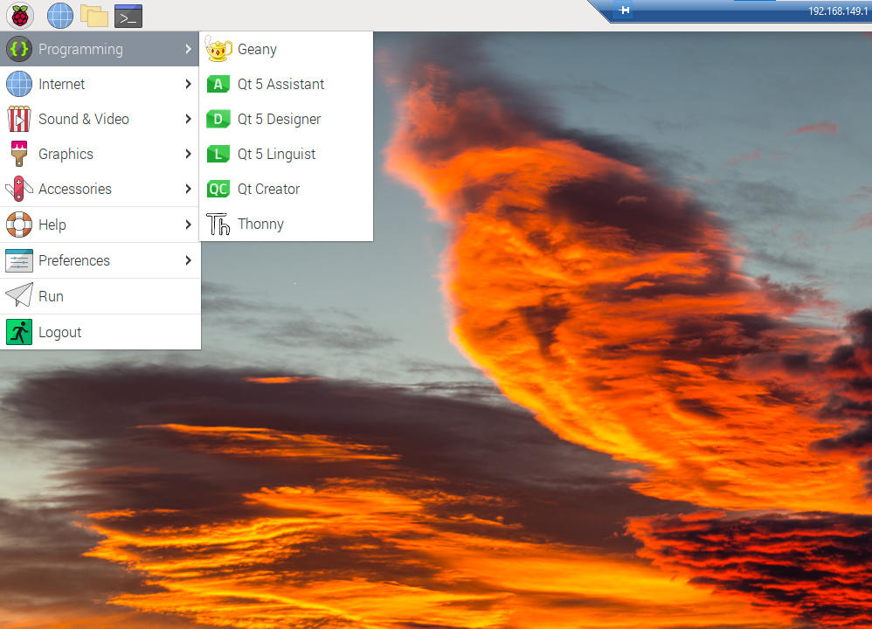
Collecting Data - Opening the Files
Navigate to the Thonny IDE
Select the Raspberry Icon in the top-left corner
Hover over Programming
Select Thonny
When you open Thonny, enter the password: ml4hst2023

Slide 8
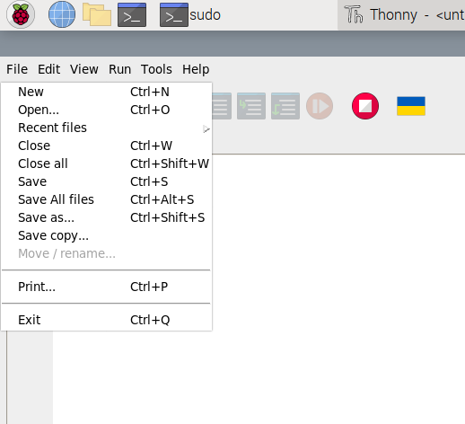
Opening the Files
To open files
Click on File in the top left
Select Open

Slide 9
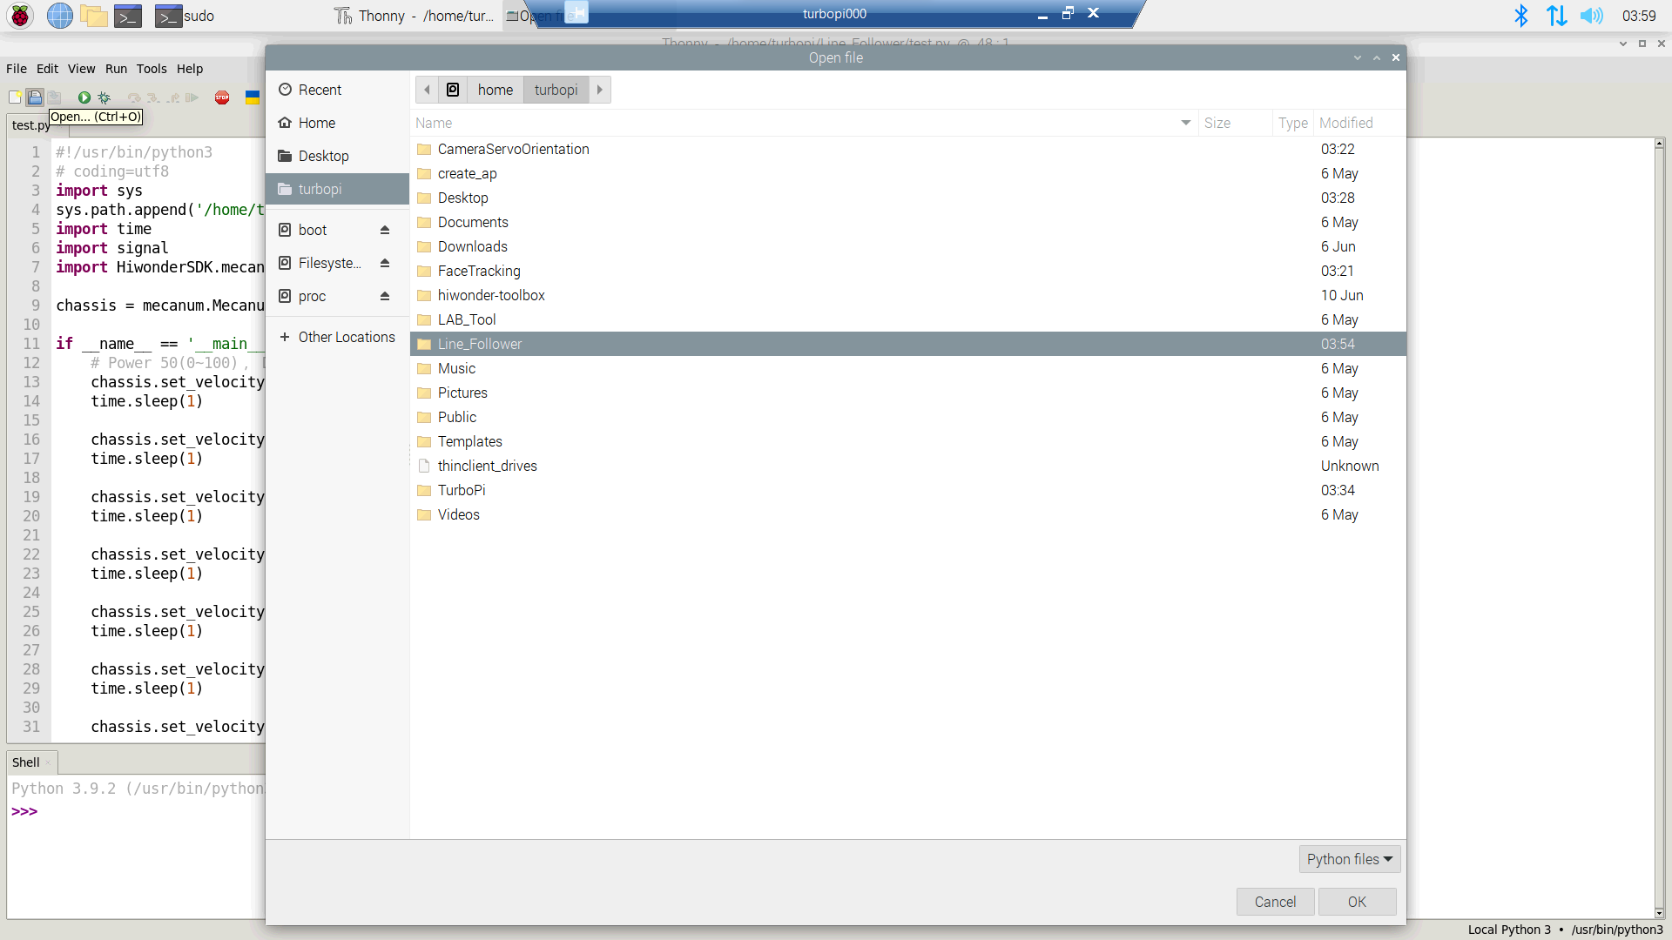
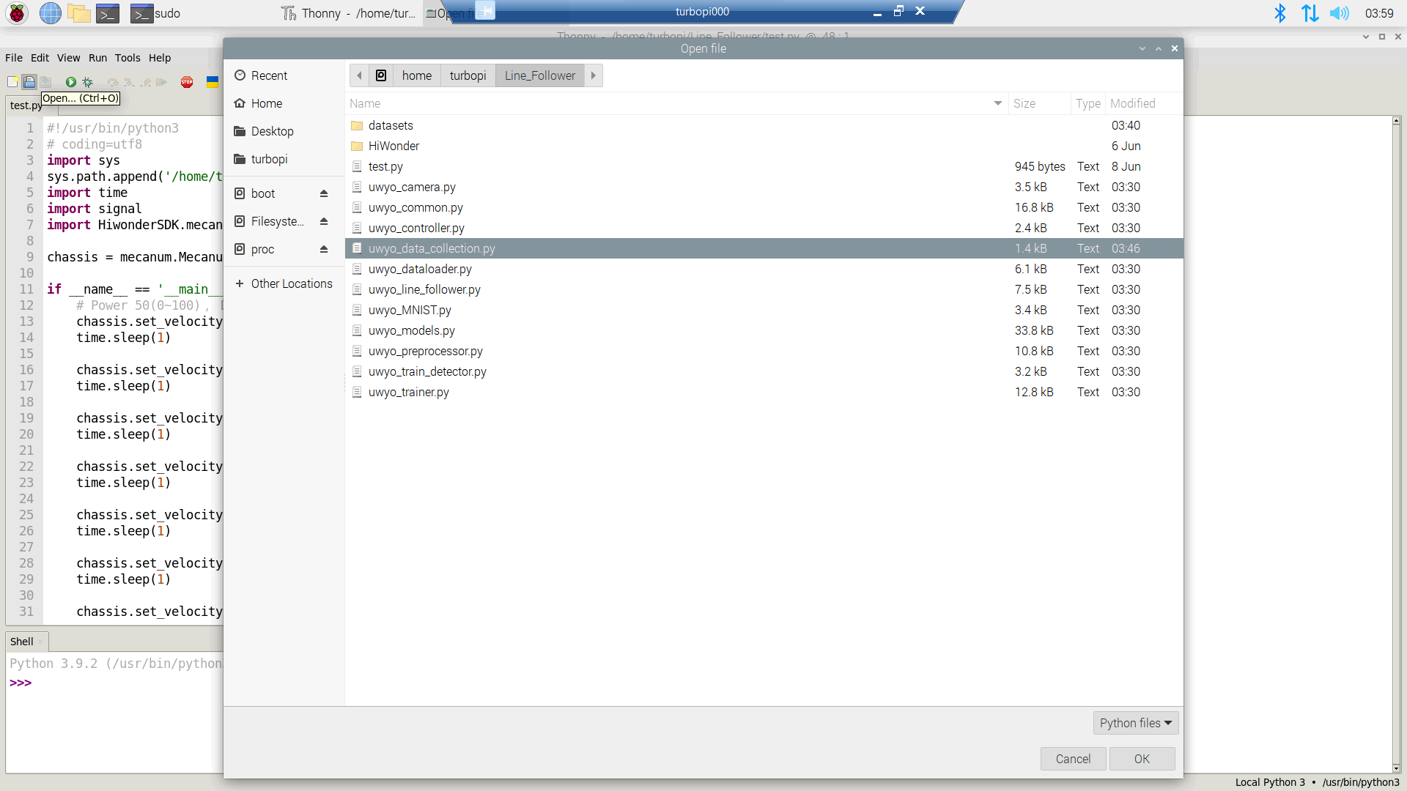
Collecting Data - Opening the Files
1. Go to home/turbopi/Line_Follower/
2. Double click on uwyo_data_collection.py

Slide 10
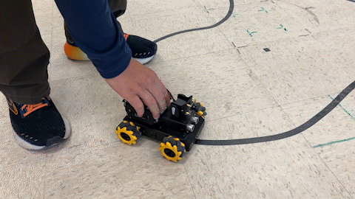
Collecting Data

Slide 11
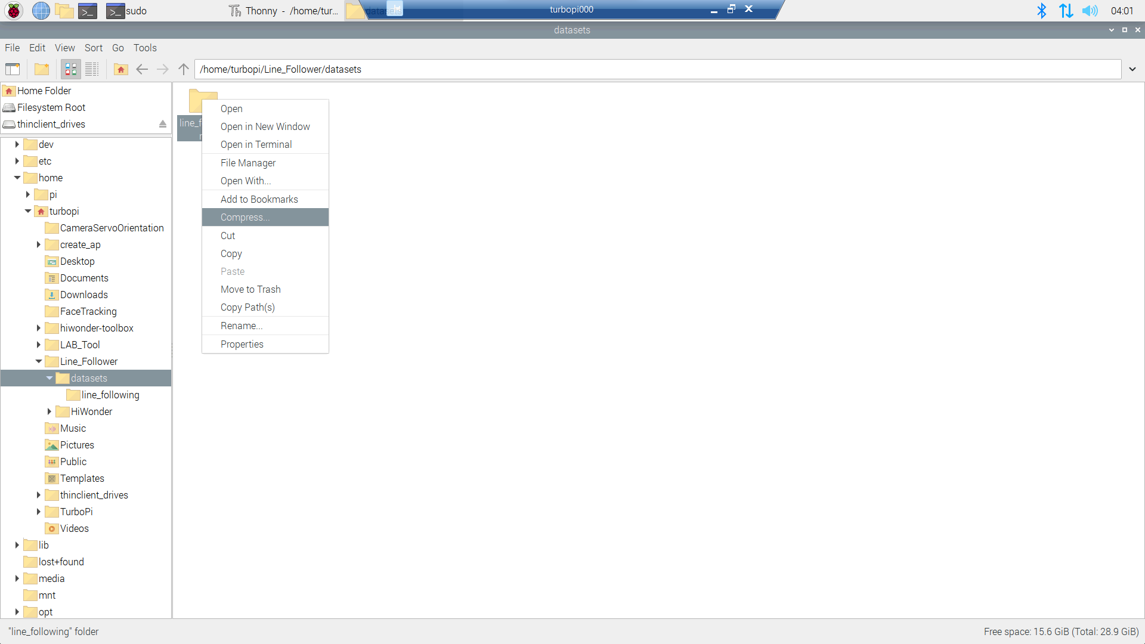
Collecting Data - Compression
Open the “File Manager”
Navigate to /home/turbopi/Line_Follower/datasets
Right click the “line_following” folder
Select “Compress” from the dropdown

Slide 12
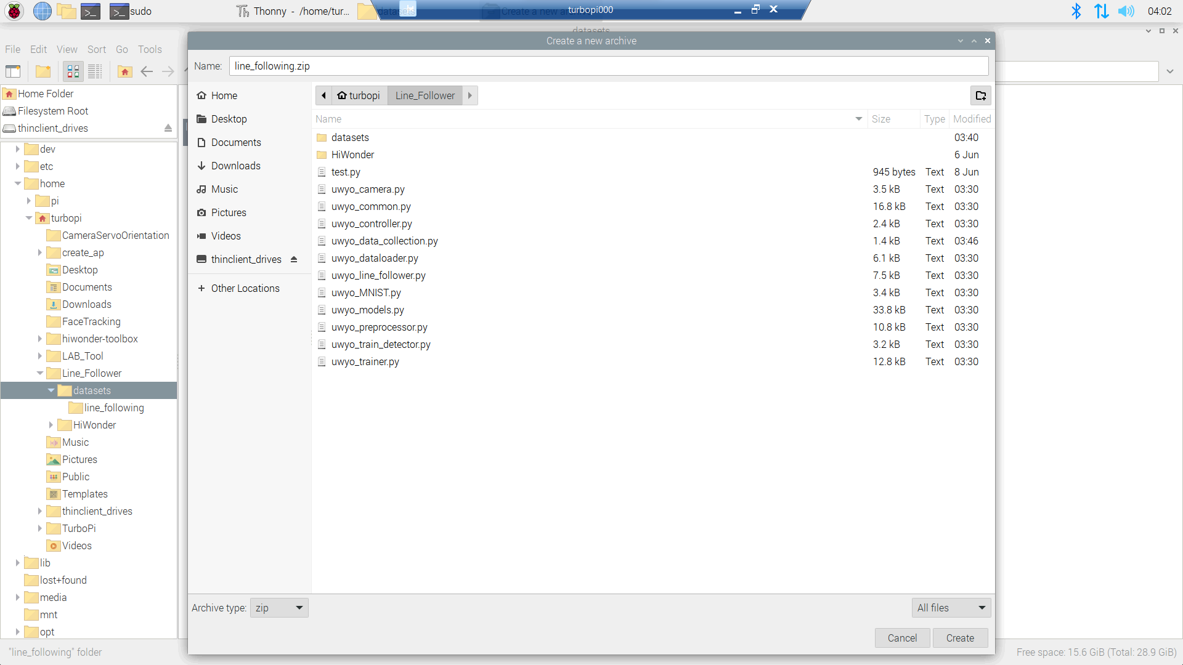
Collecting Data - Compression
Navigate to /home/turbopi/Line_Follower/
Select “zip” as the archive type in the bottom left corner
Click “Create” when finished

Slide 13
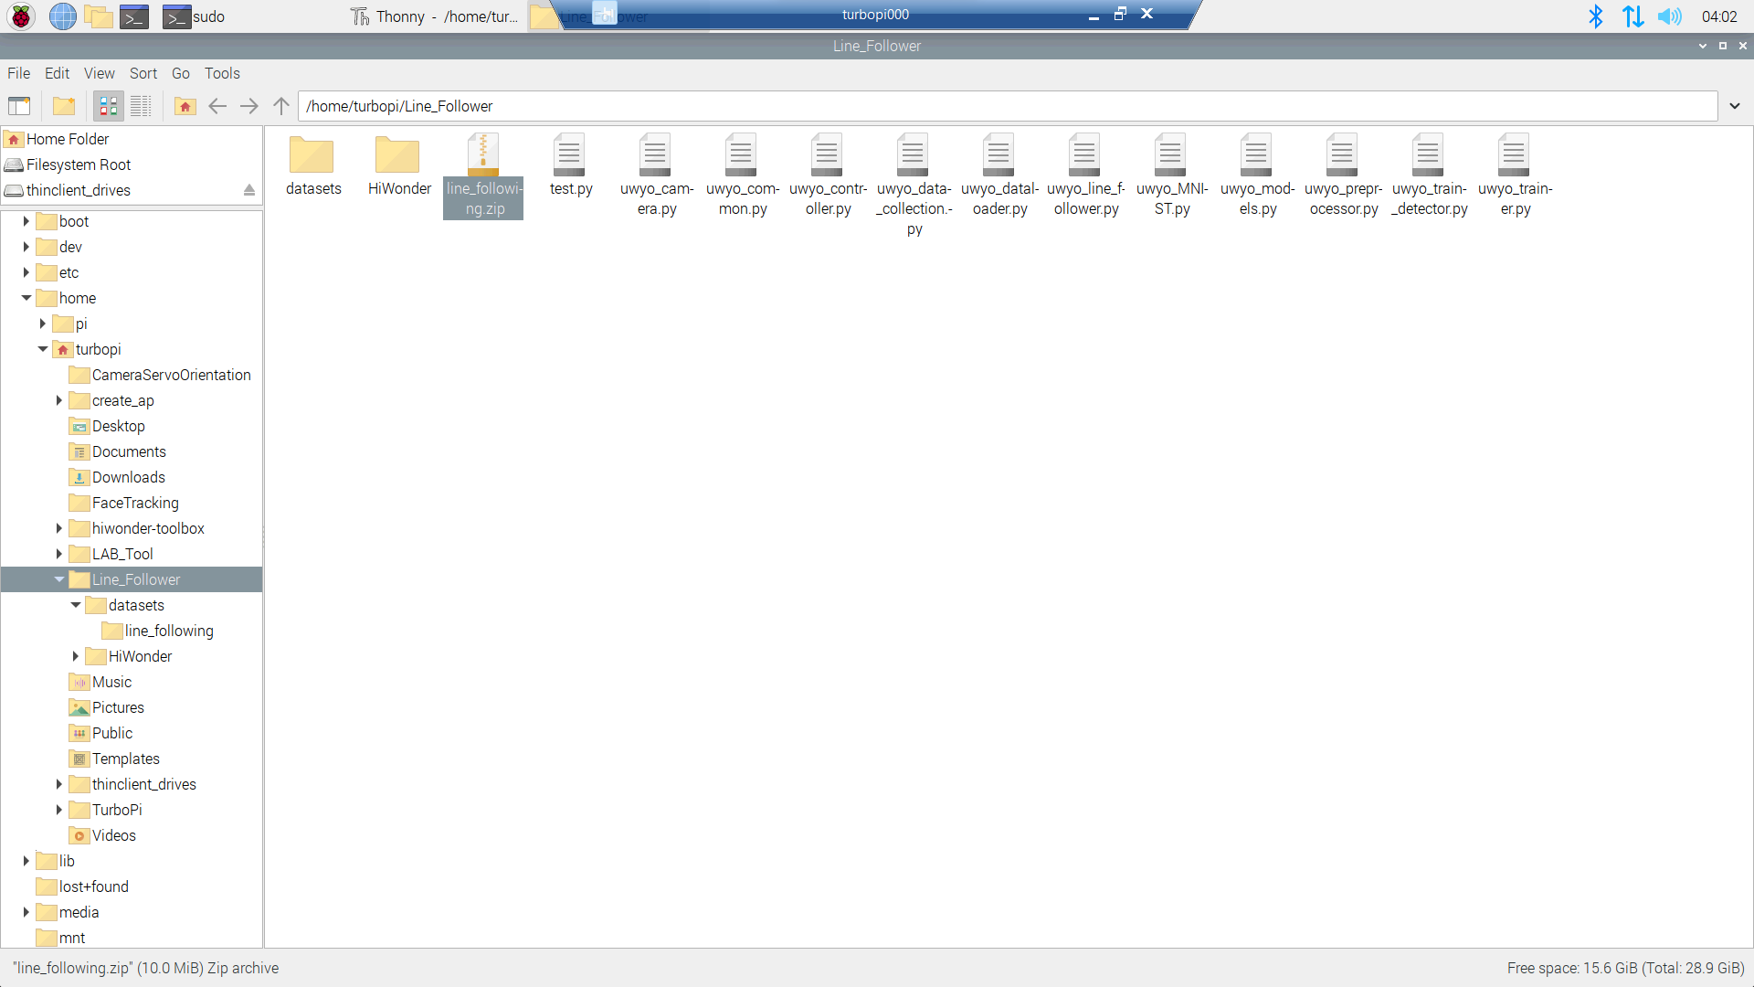
Transfer Data
Navigate to /home/turbopi/Line_Follower
Left click on line_following.zip to select it
Use the key combo “ctrl + c” to copy the file to your clipboard

Slide 14
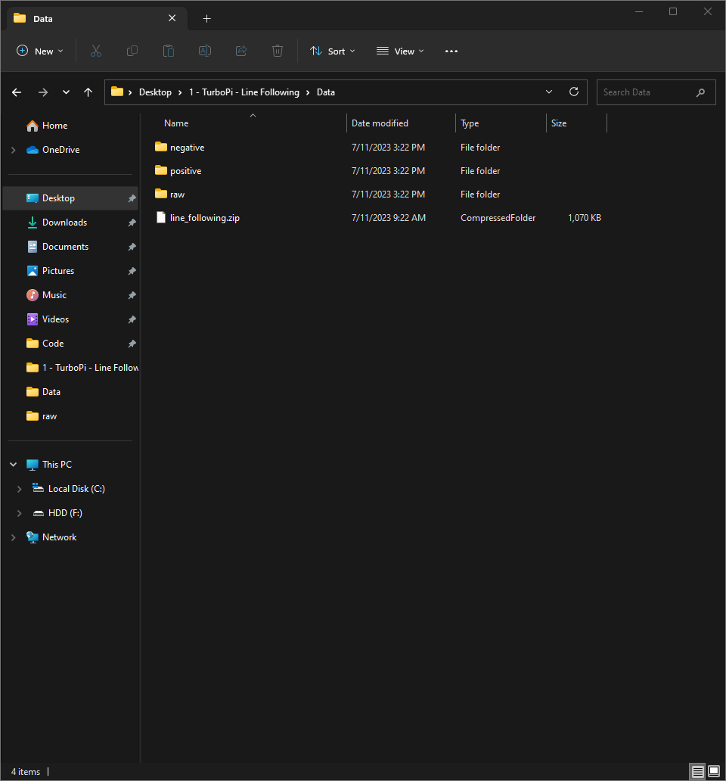
Transfer Data
On your windows computer open “File Explorer”
Navigate to Desktop/1 – TurboPi – Line Following/Data/
Use the key combo “ctrl + v” to paste the dataset into the folder

Slide 15
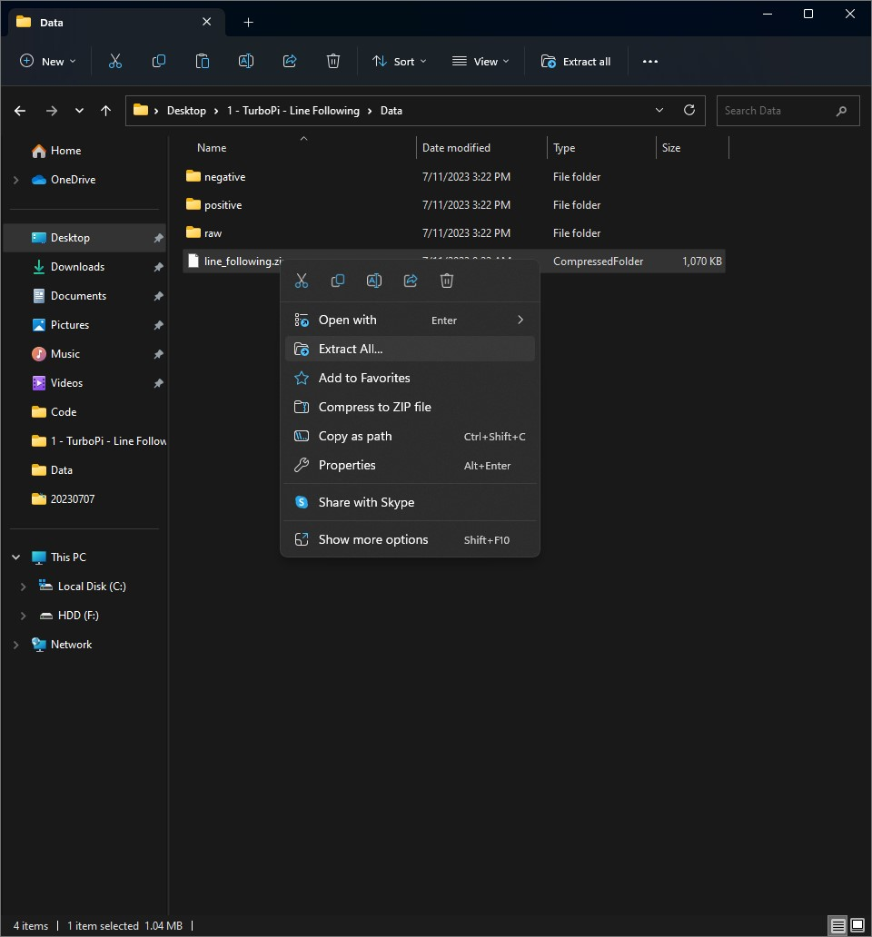
Transfer Data
Right click on the transferred zip file to open a dropdown menu
Select “Extract All…” from the dropdown menu

Slide 16
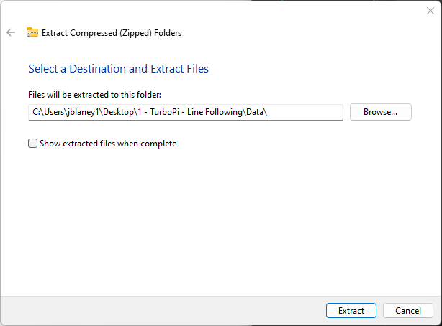
Transfer Data
One the Extract Compressed (Zipped) Folders window left click the right end of the folder path and delete “line_following”
Click “Extract” to start the extraction process

Slide 17
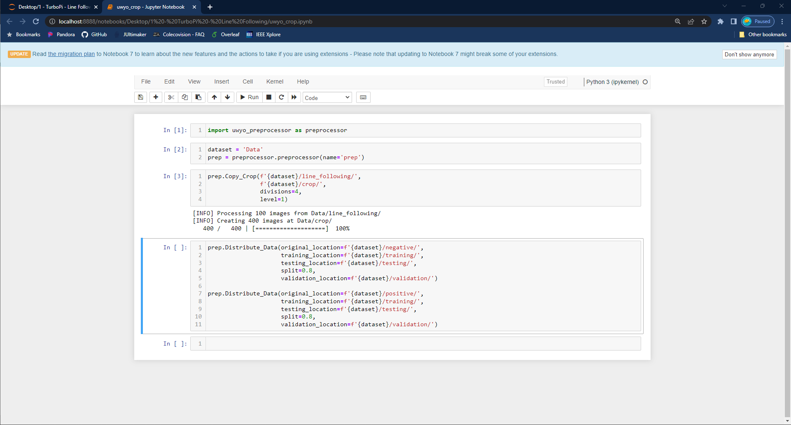
Crop Data
Open the jupyter notebook “uwyo_crop.ipynb” and run the first 3 cells

Slide 18
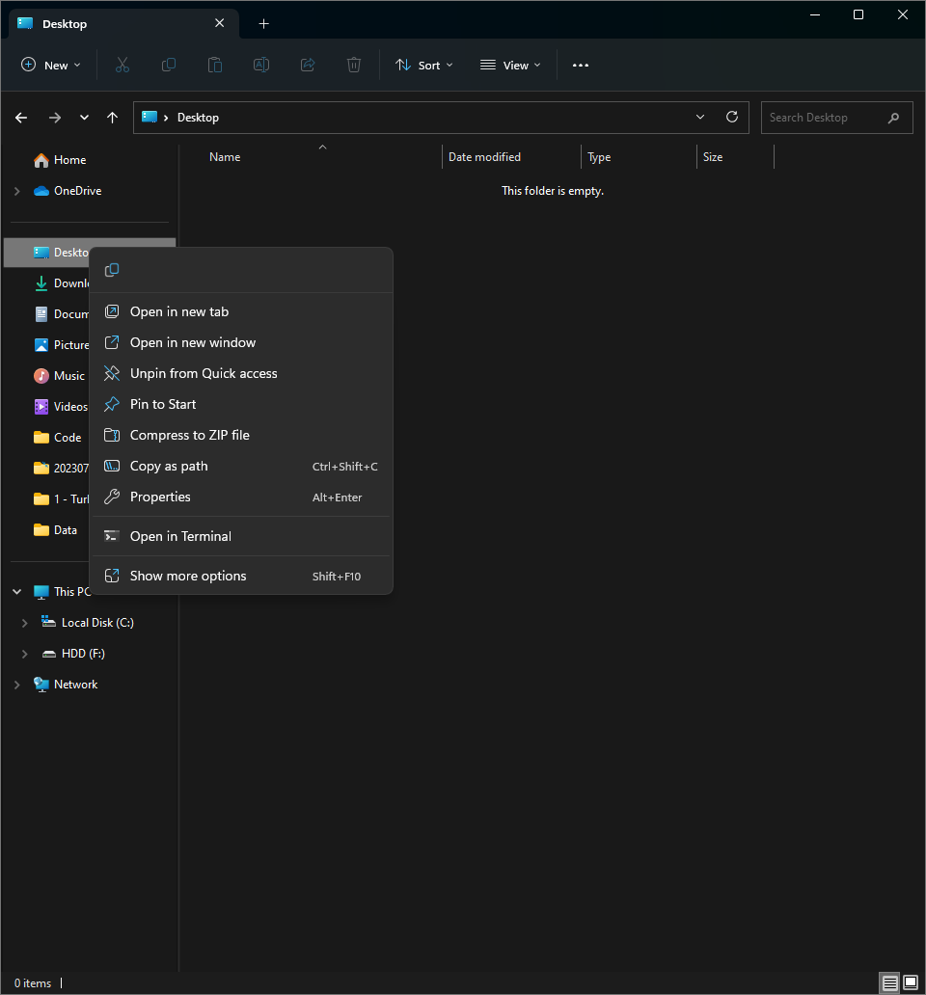
Label Data
Open two “File Explorer” windows
Open “File Explorer”
Right click on “Desktop” from the left hand menu bar
Select “Open in new window” from the dropdown menu

Slide 19
Label Data
In one “File Explorer” window, open the “Data/crop” folder we created earlier
In the other “File Explorer” window, open the “Data/positive” folder

Slide 20
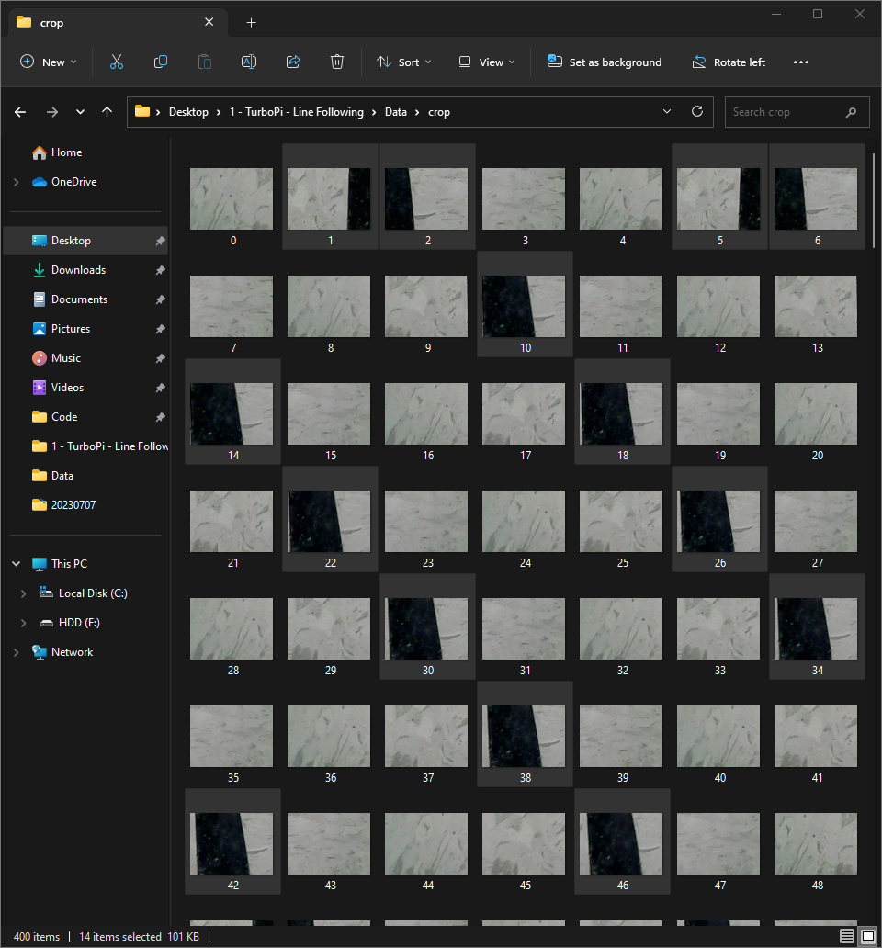
Label Data
Select cropped images with black lines by holding “ctrl” with one hand and left clicking the mouse with the other hand
We will be labeling these images as positive and we are doing them first because there will be fewer of them in our dataset
Once you have all of the visible positive examples selected left click on the last image and drag it to the positive folder
Continue this process until there are no positive examples in the crop folder

Slide 21
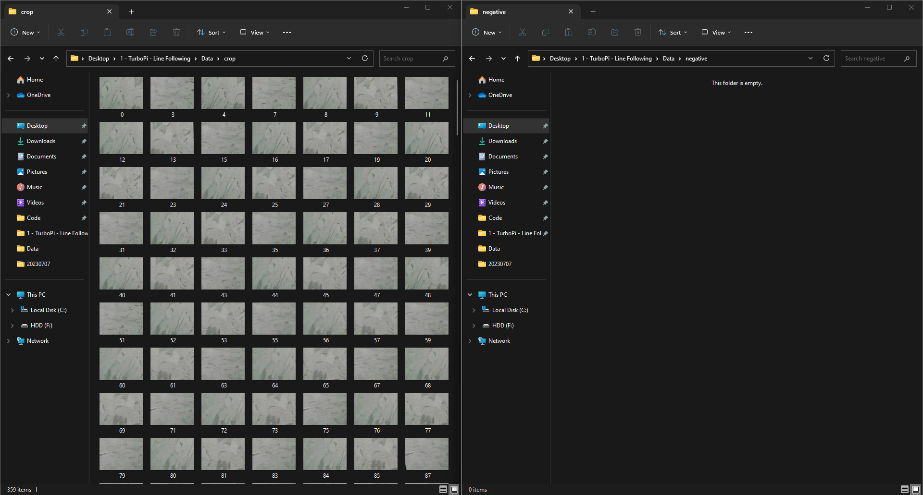
Label Data
Once all of your positive images have been labeled, change the positive window to the /Data/negative folder.
Use the key combo “ctrl + a” to select all of the files in the crop folder
Left click and drag to move all negative images to their respective folder

Slide 22
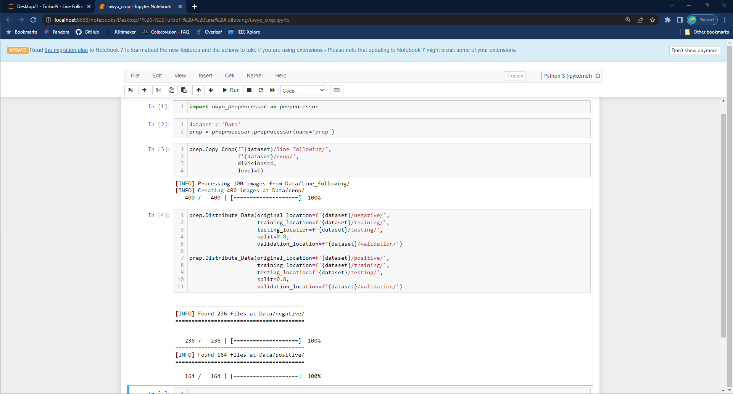
Distribute Data
In the jupyter notebook “uwyo_crop.ipynb” run cell 4

Slide 23
Machine Learning

Slide 24
ML Considerations
The computational power of the raspberry pi is limited but decisions need to be made quickly
Things which will improve performance of the TurboPi
Reducing the size and number of cropped images
Using grayscale images (1 channel input) to reduce the computations, compared to color images (3 channel inputs)
Making the neural network as small as possible to reduce computations
Running the camera, ML, and decision process on separate threads

Slide 25
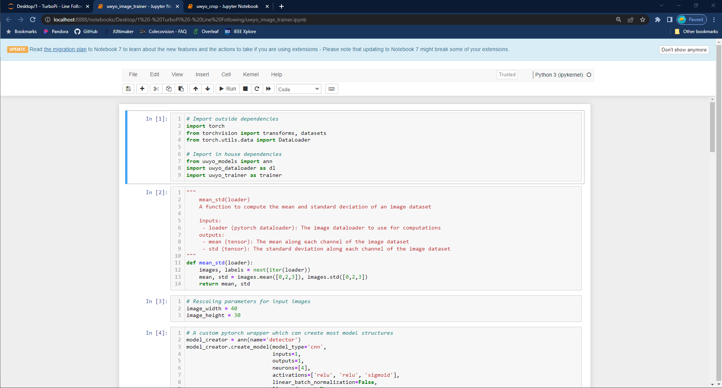
Building an ML Model
Open the jupyter notebook “uwyoimage_trainer.ipynb”

Slide 26
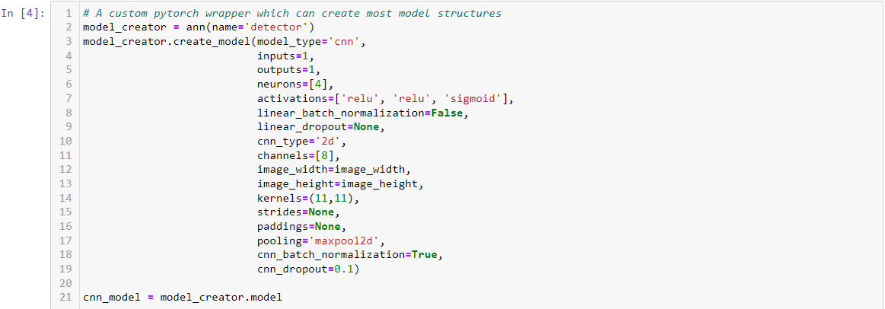
Building an ML Model

Slide 27
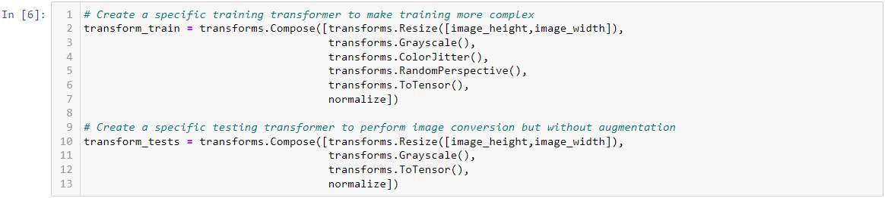
Building an ML Model

Slide 28
Experimenting with TurboPi

Slide 29
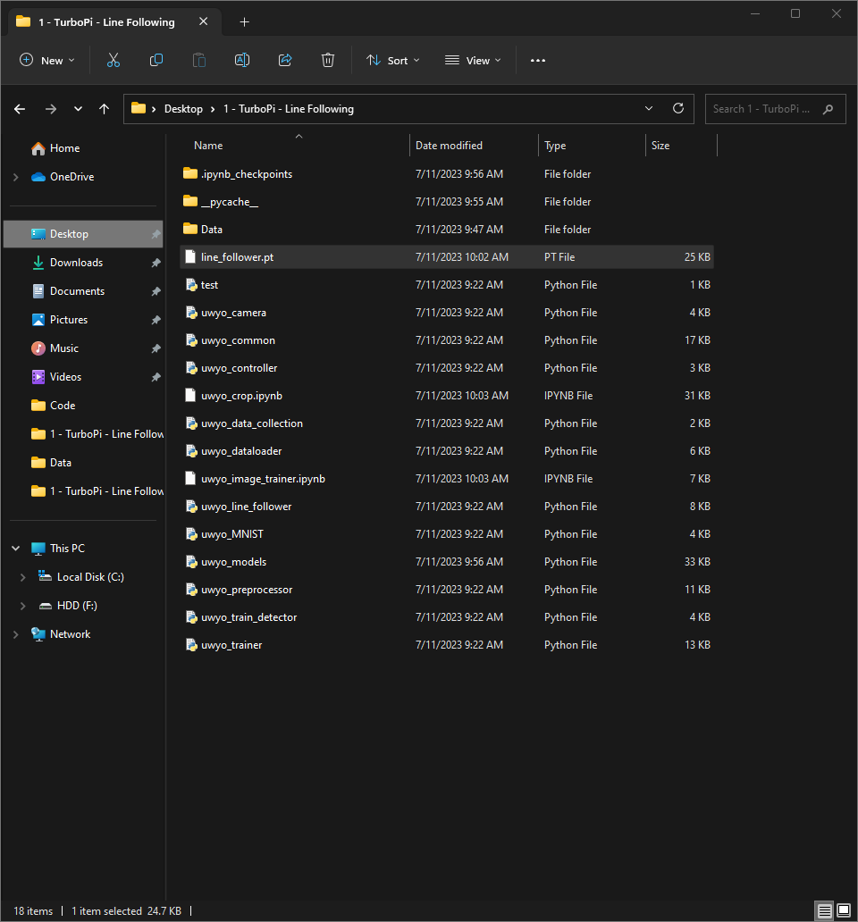
Transfer Model to TurboPi
On your windows computer open “File Explorer”
Navigate to Desktop/1 – TurboPi – Line Following/
Use the key combo “ctrl + c” to copy line_follower.pt

Slide 30
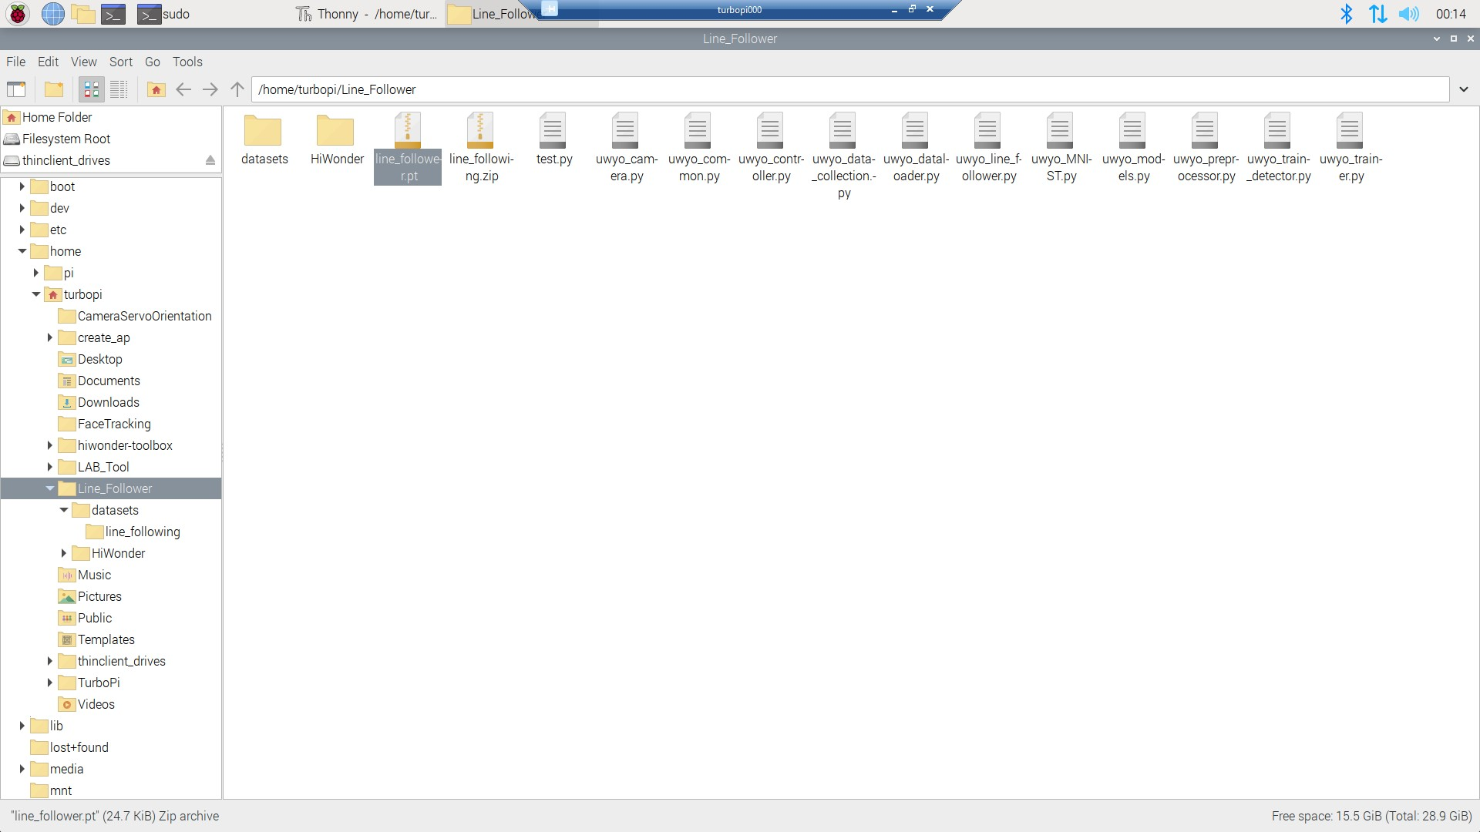
Transfer Model to TurboPi
On your TurboPi open “File Manager”
Navigate to /home/turbopi/Line_Follower/
Use the key combo “ctrl + v” to paste line_follower.pt

Slide 31
Line Following - Opening the Files
Navigate to the Thonny IDE
Select the Raspberry Icon in the top-left corner
Hover over Programming
Select Thonny
When you open Thonny, enter the password: ml4hst2023

Slide 32
Line Following - Opening the Files
To open files
Click on File in the top left
Select Open

Slide 33
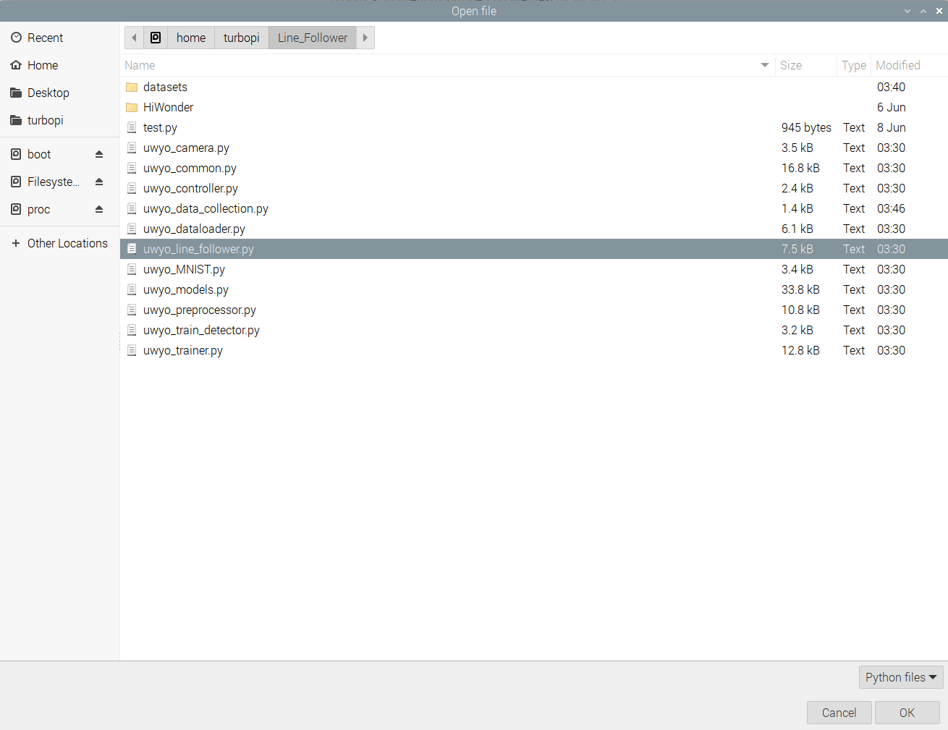
Line Following - Opening the Files
1. Go to home/turbopi/Line_Follower/
2. Double click on uwyo_line_follower.py

